Slide 1
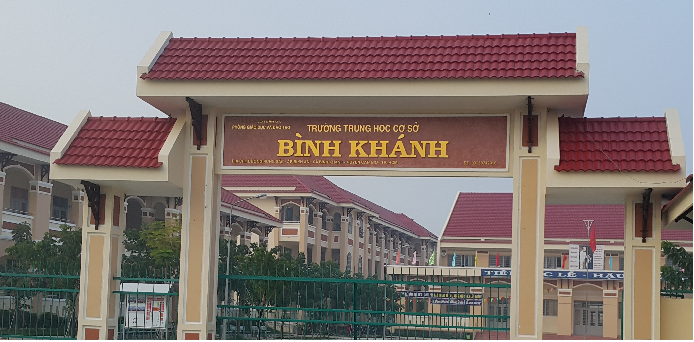
ENGLISH 8
BINH KHANH SECONDARY SCHOOL

Slide 2


BINH KHANH SECONDARY SCHOOL
Wednesday, September 15th, 2021
Unit:1. My friends
English 8
Lesson 4: Read

Slide 3

Unit1. MY FRIENDS
Lesson 4. Read
Warm up:
-How many friends do you have?
-Who are your close friends?
-What does he/she look like?

Slide 4
Unit1. MY FRIENDS
Lesson 4. Read
I. VOCABULARY:
character ( n ) :
tính cách, tính nết
sociable (adj)
hoà đồng, dễ gần gũi
generous ( adj ) :
hào phóng, rộng lượng
orphanage ( n ) :
trại mồ côi
reserved ( adj ) :
kín đáo, dè dặt
joke ( n ) :
lời nói đùa, chuyện đùa
sense of humor:
khiếu hài hước
annoy ( v ) :
làm bực mình

Slide 5
Unit1. MY FRIENDS
Lesson 4. Read
I. VOCABULARY:
character ( n ) :
tính cách, tính nết
sociable (adj)
hoà đồng, dễ gần gũi
generous ( adj ) :
hào phóng, rộng lượng
orphanage ( n ) :
trại mồ côi
reserved ( adj ) :
kín đáo, dè dặt
joke ( n ) :
lời nói đùa, chuyện đùa
sense of humor:
khiếu hài hước
annoy ( v ) :
làm bực mình

Slide 6
Unit1. MY FRIENDS
Lesson 4. Read
Matching:
-Vocabulary:
1. character (n):
a. hào phóng, rộng lượng
2. sociable (a):
b. kín đáo, dè dặt
3. generous (a):
c. khiếu hài hước
4. orphanage (n) :
d. tính nết, tính cách
5. reserved (a):
e. lời nói đùa, chuyện đùa
6. joke (n):
f. làm bực mình
7. sense of humor (n):
g. trại mồ côi
8. annoy (v):
h. hoà đồng, dễ gần gũi

Slide 7
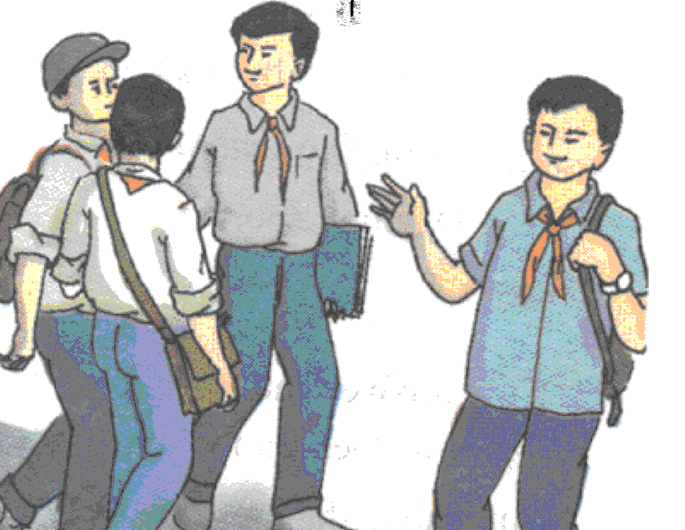
Unit:1. MY FRIENDS
Lesson 4. Read
Ba is talking about his friends.
I am lucky enough to have a lot of friends.
Of all my friends, Bao, Khai, and Song are
the ones I spend most of my time with. Each
of us, however, has a different character.
Bao is the most sociable. He is also extremely
kind and generous. He spends his free time
doing volunteer work at a local orphanage,
and he is a hard-working student who always
gets good grades.
Unlike Bao, Khai and Song are quite reserved in public. Both boys
enjoy school, but they prefer to be outside the classroom. Song is our
school’s star soccer player, and Khai likes the peace and quiet of the
local library.
I am not as outgoing as Bao, but I enjoy telling jokes. My friends
usually enjoy my sense of humor. However, sometimes my jokes
annoy them.
Although we have quite different characters, the four of us are
very close friends.

Slide 8
Unit 1. My friends
Lesson 4. Read
Multiple choice

Slide 9

a.Ba talks about_______ of his friends .

A
three
x
B
all
x
C
four
x
D
none
What a pity, you are wrong
Excellent! you are right

Slide 10
b. Bao’s volunteer work _________.

A
Does not affect his school work
x
B
Helps him make friends
x
C
takes up a lot of time
x
D
causes problems at exam time
What a pity, you are wrong
Excellent! you are right

Slide 11
c. Khai and Song _________ .
x
A
like quiet places
x
B
enjoy sports
x
C
dislike school

D
don’t talk much in public
Excellent! you are right
What a pity, you are wrong

Slide 12
d. Ba’ friends sometimes ______ his jokess .
x
A
answer
x
B
laugh at

C
Get tired of
x
D
do not listen to
Excellent! you are right
What a pity, you are wrong

Slide 13

Unit:1. My friends
Lesson:4. Read
Answer the questions
a) How does Ba feel having a lot of friends?
b) Who is the most sociable?
c) Who likes reading?
d) What is a bad thing about Ba’s jokes?
e) Where does Bao spend his free time?
f) Do you and your friends have the same or
different character?

Slide 14
Lucky numbers
1
2
3
4
5
6
7
8

Slide 15


How does Ba feel having a lot of friends?
→ He feels lucky enough having a lot of friends.

Slide 16
Lucky number !

Slide 17

Who is the most sociable?
→ Bao is the most sociable.

Slide 18
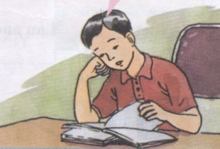
Who likes reading?
→ Khai likes reading.

Slide 19


What is a bad thing about Ba’s jokes?
→ They sometimes annoy his friends.

Slide 20

Where does Bao spend his free time?
→He spends his free time doing volunteer work at a local orphanage.

Slide 21

Do you and your friends have the same or different character?
We have the same characters.
(We have quite different characters.)
Lucky Number?

Slide 22


Lucky number !

Slide 23
Answers
a) He feels lucky enough having a lot of friends.
b) Bao is the most sociable.
c) Khai likes reading.
d) They sometimes annoy his friends.
e) He spends his free time doing volunteer work at a local orphanage.
f) I and My friends have the same characters.
(I and my friends have quite different characters.)

Slide 24
* Talking about Ba’s friends:
Song Khai Bao
- reserved
- enjoys school
- likes reading
- sociable,
kind, generous
- a volunteer
- a hard-working student
- reserved
- enjoys school
- a school’s star player

Slide 25
Homework
Learn by heart new words
Prepare : Write

